Slide 1
Unit 2- Matter
II. Classification of Matter
(p.15-17, Modern Chemistry)
  Matter Flowchart
  Pure Substances
  Mixtures
C. Johannesson

Slide 2
A. Matter Flowchart
MATTER
yes
no
Can it be physically separated?
MIXTURE
PURE SUBSTANCE
yes
Is the composition uniform?
no
yes
Can it be chemically decomposed?
no
Homogeneous Mixture
(solution)
Heterogeneous Mixture
Compound
Element
Colloids
C. Johannesson
Suspensions

Slide 3
A. Matter Flowchart
Examples:
  graphite
  pepper
  sugar(sucrose)
  paint
  soda
  element
  hetero. mixture
  compound
  hetero. mixture
  solution
C. Johannesson

Slide 4
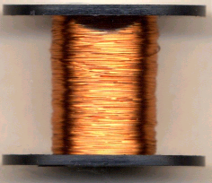
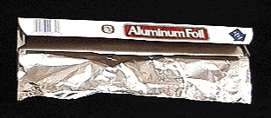
B. Pure Substances
Element
  composed of one type of atom
  EX: copper wire, aluminum foil
C. Johannesson

Slide 5
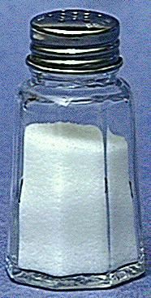
B. Pure Substances
Compound
  composed of 2 or more elements in a fixed ratio
  properties differ from those of individual elements
  EX: table salt (NaCl)
C. Johannesson

Slide 6
B. Pure Substances
Law of Definite Composition
  A given compound always contains the same, fixed ratio of elements.
Law of Multiple Proportions
  Elements can combine in different ratios to form different compounds.
C. Johannesson

Slide 7
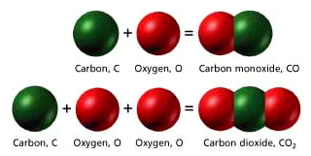
B. Pure Substances
For example…
Two different compounds,
each has a definite composition.
C. Johannesson

Slide 8
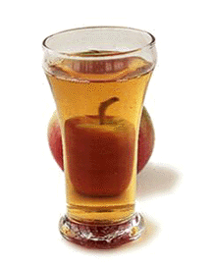
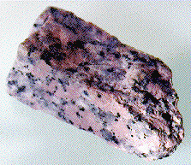
C. Mixtures
Variable combination of 2 or more pure substances.
Heterogeneous
Homogeneous
C. Johannesson

Slide 9
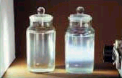
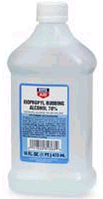
C. Mixtures
Solution
  homogeneous
  very small particles
  no Tyndall effect
Tyndall Effect
  particles don’t settle
  EX: rubbing alcohol
C. Johannesson

Slide 10
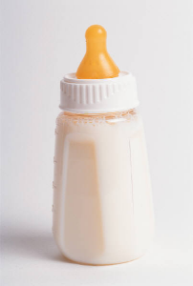
C. Mixtures
Colloid
  heterogeneous
  medium-sized particles
  Tyndall effect
  particles don’t settle
  EX: milk
C. Johannesson

Slide 11
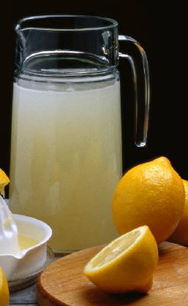
C. Mixtures
Suspension
  heterogeneous
  large particles
  Tyndall effect
  particles settle
  EX: fresh-squeezed
  lemonade
C. Johannesson

Slide 12
C. Mixtures
Examples:
  mayonnaise
  muddy water
  fog
  saltwater
  Italian salad dressing
  colloid
  suspension
  colloid
  solution
  suspension
C. Johannesson

